Slide 1
Classifying Electrical Impedance Tomography images by resistances based on contours
Sudhanva Narayana
Machine Learning Intern
Faststream Technologies
Vinay Bansal
Chief Executive Officer
Faststream Technologies
Vinod Agrawal
Chief Technology Officer
Faststream Technologies

Slide 2
Objective
To classify Electrical Impedance Tomography images
Images with higher intensities are classified as affected images
Images with lower intensities are classified as non-affected images
Performance of various Machine Learning algorithms on these images are measured
Notes:
Impedance: the effective resistance of an electric circuit or component to alternating current, arising from the combined effects of ohmic resistance and reactance.

Slide 3
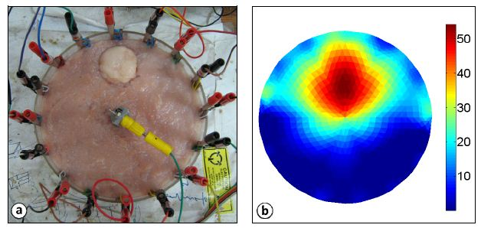
Sample Image of an EIT

Slide 4
Background
Human body has electrical properties
Surface electrodes are attached to the skin around the body part
Small alternating currents will be applied to the electrodes
Impedance is measured across electrodes
Notes:
Impedance: the effective resistance of an electric circuit or component to alternating current, arising from the combined effects of ohmic resistance and reactance.

Slide 5
Methodology
Sample image is imported using OpenCV and is converted into a 2D Matrix
To simplify the process, it is converted to grayscale
Each value in the matrix represents intensities of either black or white (0 being black and 1 being white)
1000 random-related images are created based on the matrices and its values
Notes:
OpenCV: Open Source Computer Vision Library

Slide 6
Methodology
The generated images are read back into code
Images with higher intensities are labelled as affected images programmatically
A dataset is created based on the number of pixels in the image
Mean intensity ranges are calculated and are assigned labels (colours) correspondingly
Notes:
Linespace: Returns evenly spaced numbers over a specified interval.
Returns num evenly spaced samples, calculated over the interval [start, stop].
Meshgrid: Returns coordinate matrices from coordinate vectors.
Make N-D coordinate arrays for vectorized evaluations of N-D scalar/vector fields over N-D grids, given one-dimensional coordinate arrays x1, x2,…, xn.

Slide 7
Methodology
A dataset of 8 intensity ranges (columns) and 1000 values (rows) are created
Binary targets are generated and are appended to the existing dataset as a target column
If the pixel count is more than the mean, the image is categorised as ‘1’
If the pixel count is less than the mean, the image is categorised as ‘0’
Notes:
Target: 0 or 1 - Classification

Slide 8
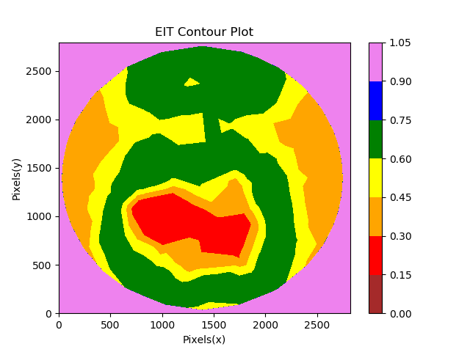
Sample Image Generated
The range of values are assigned colours only for the purpose of representation
Originally, the image is still grayscale
The red region is considered affected

Slide 9
Machine Learning
Data attributes with pixel counts greater than zero are selected as features
Data is split into training and test sets and the model is trained on the training set
The model is fit to the test set and values are predicted
Performance of various classification algorithms are measured using cross-validation
Notes:
Cross Validation: Cross-validation is a statistical method used to estimate the skill of machine learning models

Slide 10
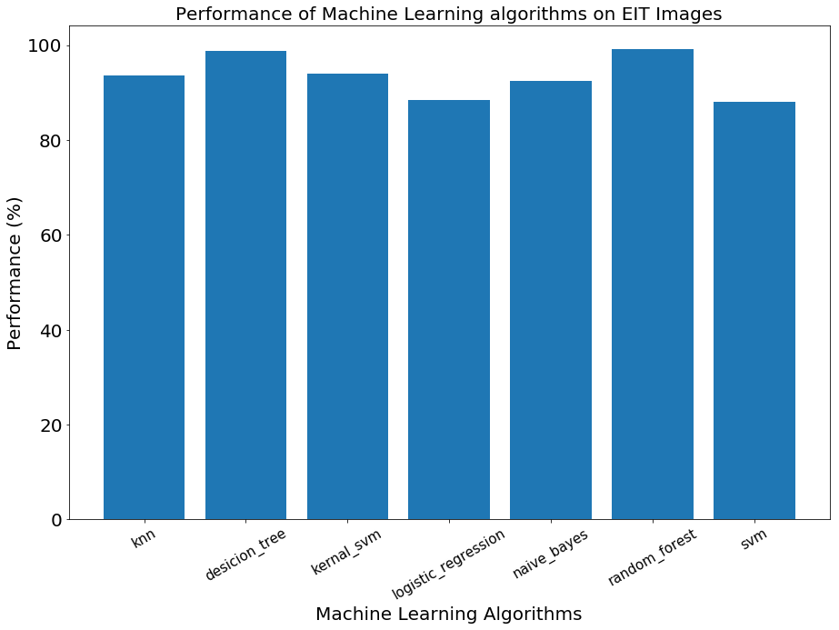
Results
No | Algorithms | Algorithms’ accuracy
1 | K Nearest Neighbours | 93.6%
2 | Decision Tree Classification | 98.8%
3 | Kernel Support Vector Machines | 94%
4 | Logistic Regression | 88.4%
5 | Naive Bayes | 92.4%
6 | Random Forest Classification | 99.2%
7 | Support Vector Machines | 88%

Slide 11
Conclusion
The performance data is collected based on the confusion matrix produced by the algorithms
Decision Tree and Random Forest classifiers performed better than linear classifiers and topped at almost 99%
Similar results can be expected on unseen data.
Notes:
Logistic Regression and SVM showed similar results at 88%. Naïve Bayes, Kernel SVM and K Nearest Neighbours showcased a significant improvement resulting at around 93%. However, Decision Tree and Random Forest classifiers performed better than linear classifiers. Random Forest and Decision Tree both topped at 99% making them the best algorithm to use for this kind of dataset.

